Slide 1
The Memory of the Civil War in American Culture

Slide 2
John Brown’s Body
John Brown's body lies a-mouldering in the grave,
John Brown's body lies a-mouldering in the grave,
But his soul goes marching on.
Chorus:Glory, glory, hallelujah, /Glory, glory, hallelujah,/His soul goes marching on.
The stars above in Heaven now are looking kindly down,
The stars above in Heaven now are looking kindly down,
On the grave of old John Brown. Chorus:
He captured Harper’s Ferry, with his nineteen men so true And frightened "Old Virginny" till she trembled thru and thru; They hanged him for a traitor, they themselves the traitor crew, But his soul is marching on. Chorus:
He's gone to be a soldier in the Army of the Lord, /| He's gone to be a soldier in the Army of the Lord, But his soul goes marching on. Chorus:

Slide 3
Battle-Hymn of the Republic by Julia Ward Howe
Mine eyes have seen the glory of the coming of the Lord:
He is trampling out the vintage where the grapes of wrath are stored;
He hath loosed the fatal lightning of his terrible swift sword:
His truth is marching on.
I have seen Him in the watch-fires of a hundred circling camps;
They have builded Him an altar in the evening dews and damps;
I can read His righteous sentence by the dim and flaring lamps.
His Day is marching on.
I have read a fiery gospel, writ in burnished rows of steel:
“As ye deal with my contemners, so with you my grace shall deal;
Let the Hero, born of woman, crush the serpent with his heel,
Since God is marching on.”
He has sounded forth the trumpet that shall never call retreat;
He is sifting out the hearts of men before his judgment-seat:
Oh! be swift, my soul, to answer Him! be jubilant, my feet!
Our God is marching on.
In the beauty of the lilies Christ was born across the sea,
With a glory in his bosom that transfigures you and me:
As he died to make men holy, let us die to make men free,
While God is marching on.

Slide 4
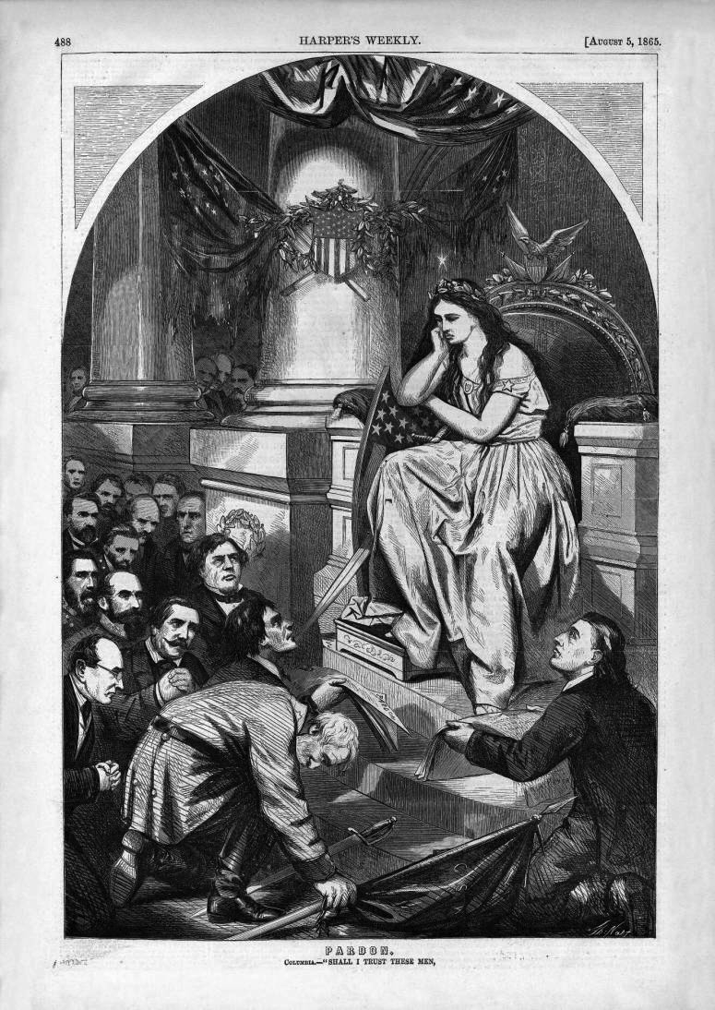
Reconstruction and the Politics of Race
Thomas Nast’s Reconstruction.
Caption: Pardon.
Columbia: “Shall I Trust These Men…. Harper’s Weekly, August 5, 1865

Slide 5
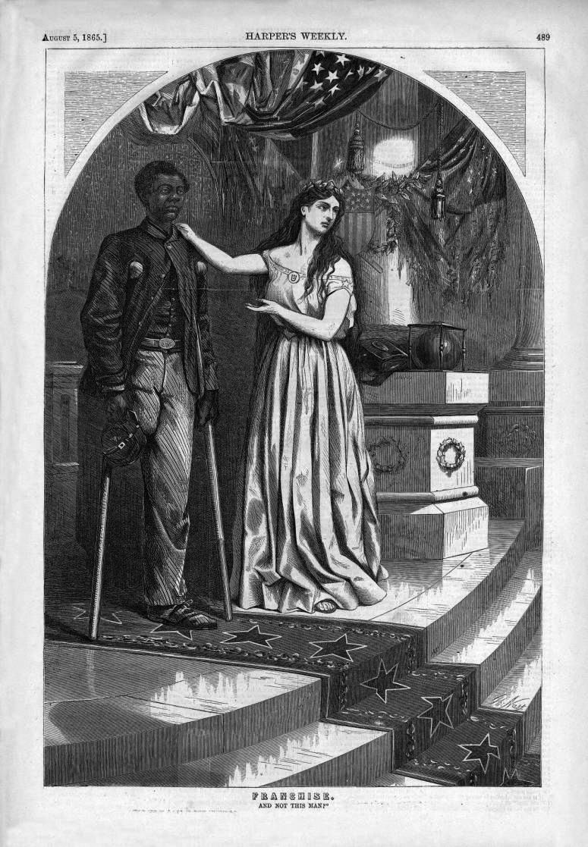
Franchise. ….And Not This Man?” Harper’s Weekly, August 5, 1865

Slide 6
Mississippi Black Code of 1865—Excerpt on “vagrancy”
Vagrancy Law
Section 1. Be it enacted by the legislature of the state of Mississippi, that all rogues and vagabonds, idle and dissipated persons, beggars, jugglers, or persons practising unlawful games or plays, runaways, common drunkards, common nightwalkers, pilferers, lewd, wanton, or lascivious persons, in speech or behavior, common railers and brawlers, persons who neglect their calling or employment, misspend what they earn, or do not provide for the support of themselves or their families or dependents, and all other idle and disorderly persons, including all who neglect all lawful business, or habitually misspend their time by frequenting houses of ill-fame, gaming houses, or tippling shops, shall be deemed and considered vagrants under the provisions of this act; and, on conviction thereof shall be fined not exceeding $100, with all accruing costs, and be imprisoned at the discretion of the court not exceeding ten days.
Section 2. Be it further enacted, that all freedmen, free Negroes, and mulattoes in this state over the age of eighteen years found on the second Monday in January 1966, or thereafter, with no lawful employment or business, or found unlawfully assembling themselves together either in the day or nighttime, and all white persons so assembling with freedmen, free Negroes, or mulattoes, or usually associating with freedmen, free Negroes, or mulattoes on terms of equality, or living in adultery or fornication with a freedwoman, free Negro, or mulatto, shall be deemed vagrants; and, on conviction thereof, shall be fined in the sum of not exceeding, in the case of a freedman, free Negro, or mulatto, 150, and a white man, $200, and imprisoned at the discretion of the court, the free Negro not exceeding ten days, and the white man not exceeding six months.

Slide 7
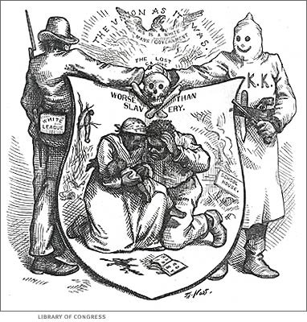

Slide 8
Harper’s Weekly, August 8, 1868

Slide 9
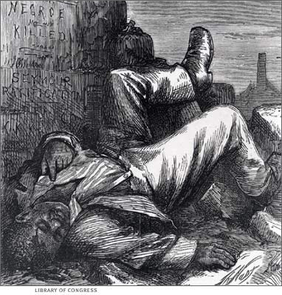

Slide 10
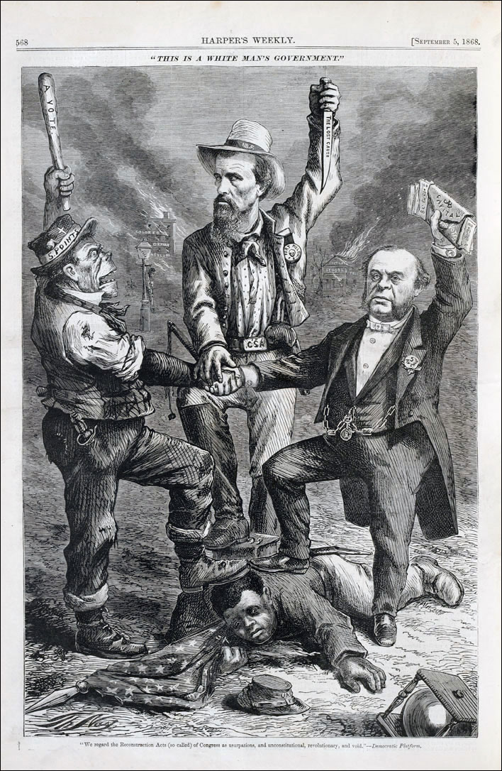

Slide 13
Reconstruction and Black Political Activism
Electioneering at the South, July 25, 1868

Slide 14
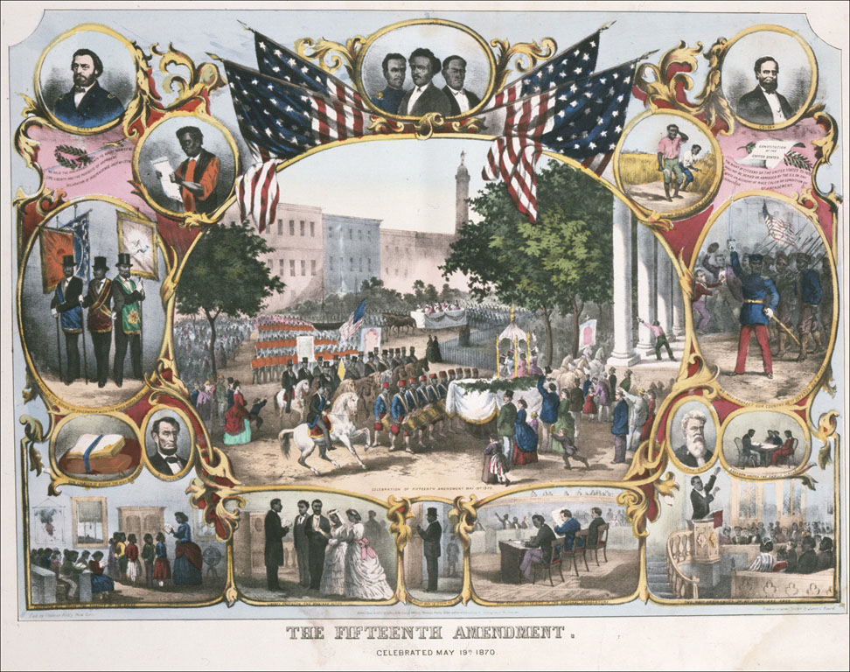

Slide 15
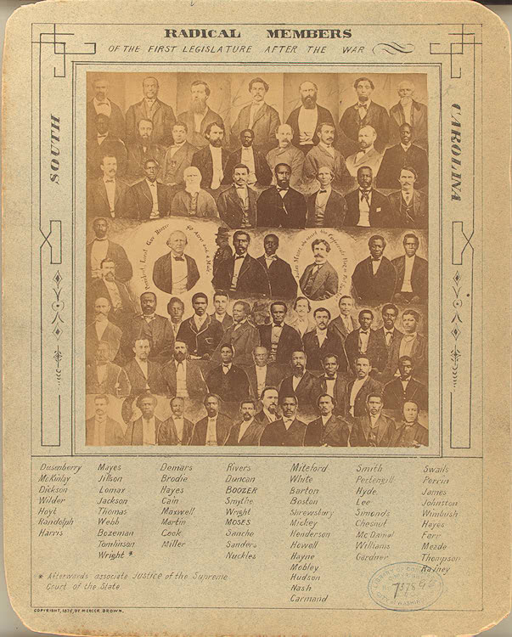

Slide 16
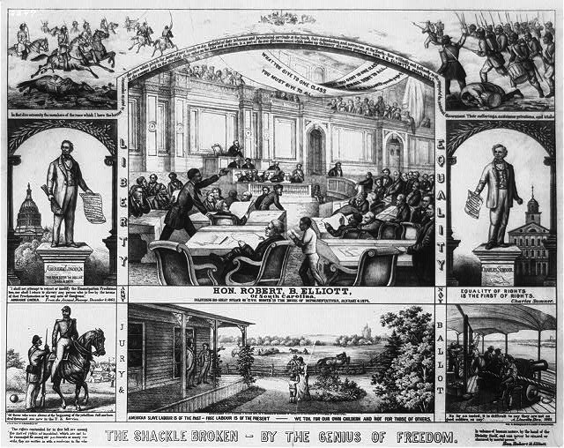

Slide 17
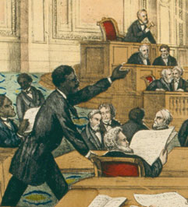
Robert Elliott of South Carolina

Slide 18
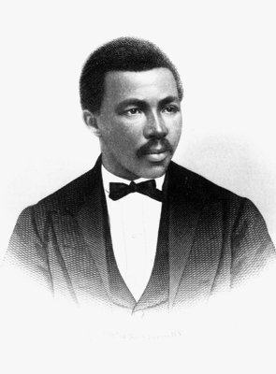
Robert Elliott

Slide 19
Hiram Revels
From Harper’s Weekly, February 19, 1870

Slide 20
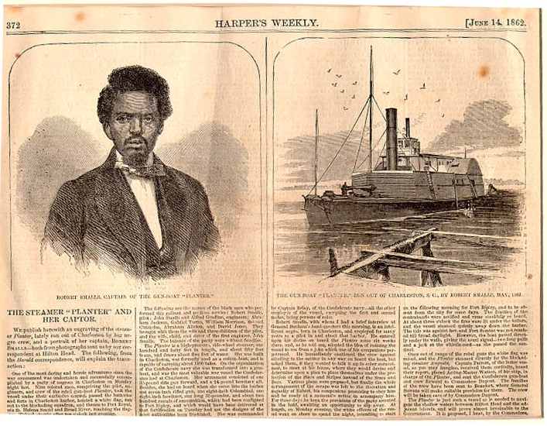

Slide 21
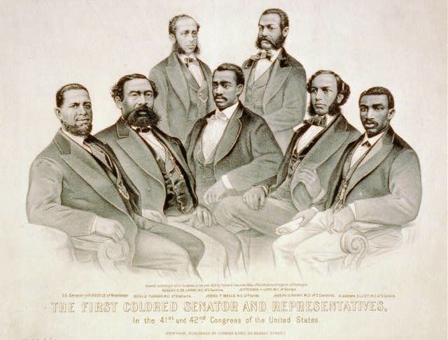

Slide 22
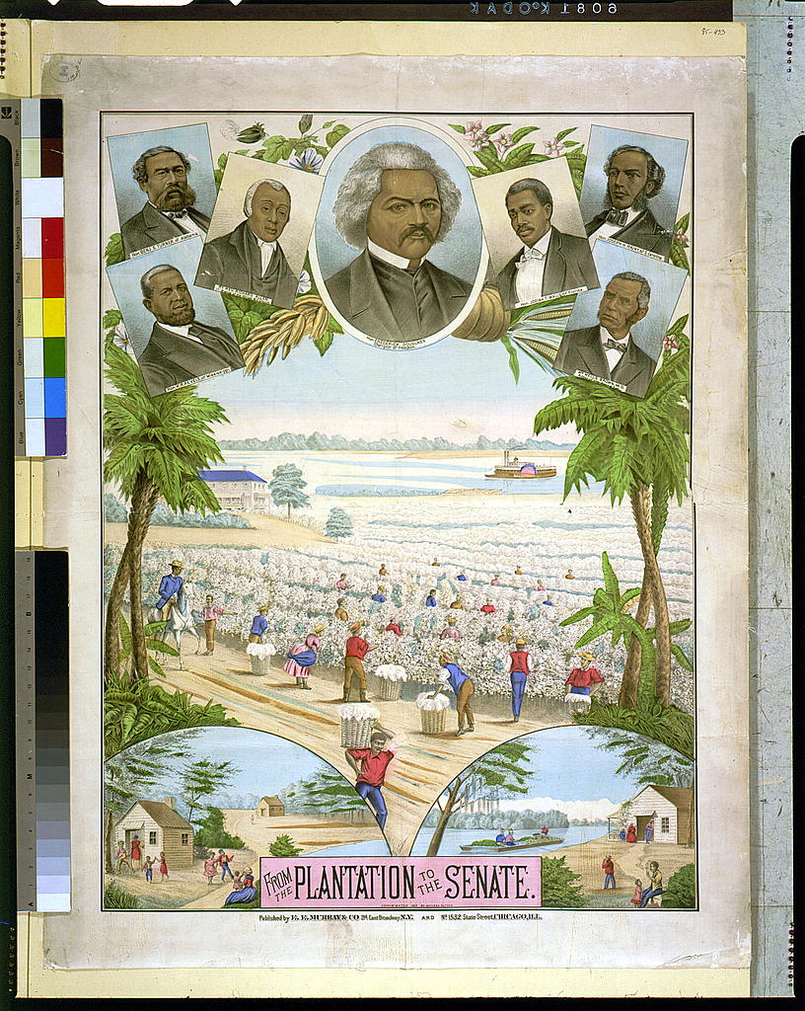

Slide 23
Civil War Memory and the Re-imagination of Slavery
The “Lost Cause”
Uncle Tom Shows
Thomas Dixon and The Clansman (1905)
Dissenters against “Reunionism” and dominant modes of Civil War memory
D. W. Griffith and The Birth of a Nation (1915)

Slide 24
Monument to Robert E. Lee, Richmond, Va.

Slide 25
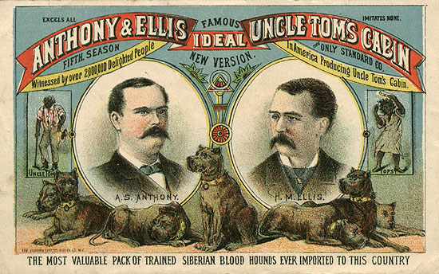

Slide 26
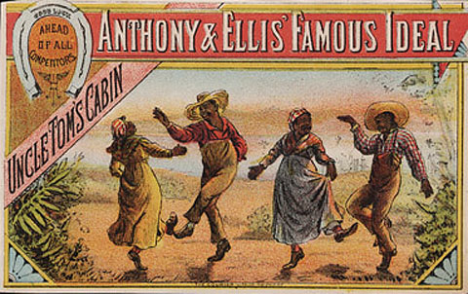

Slide 27
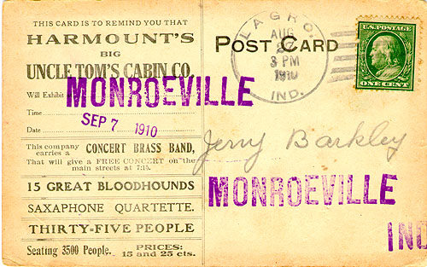

Slide 28
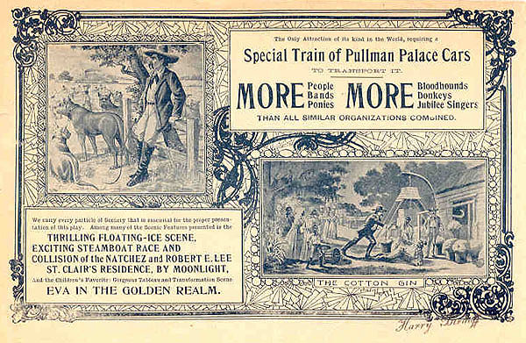

Slide 29
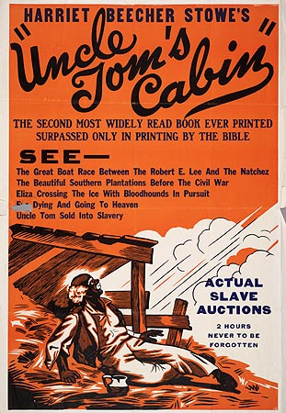

Slide 30
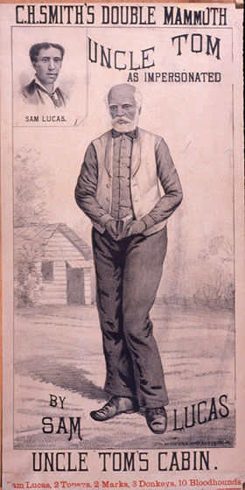

Slide 31
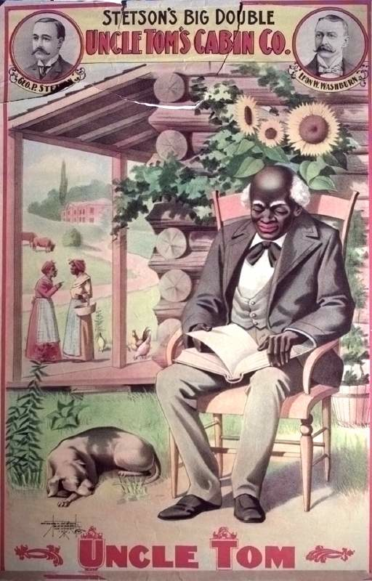

Slide 32
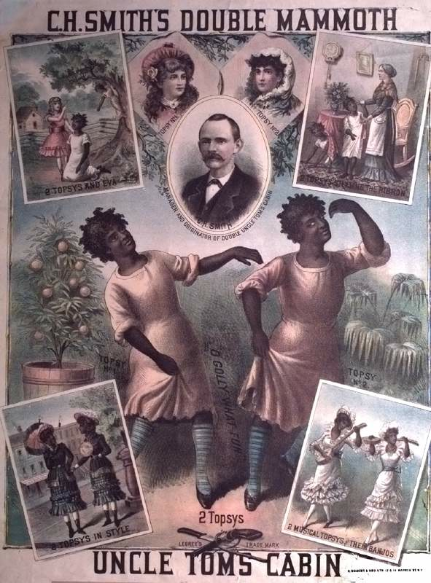

Slide 33
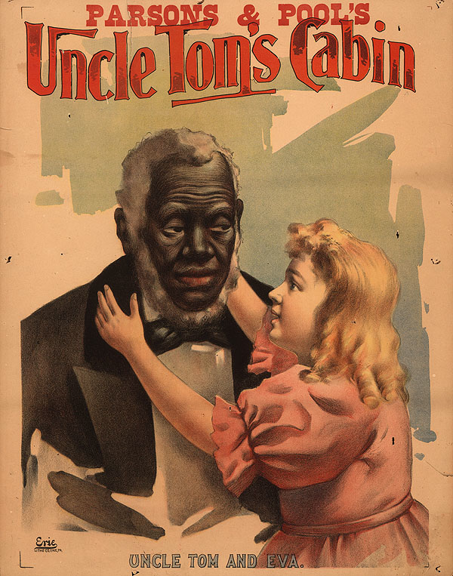

Slide 34
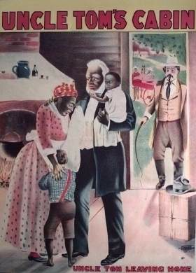

Slide 35
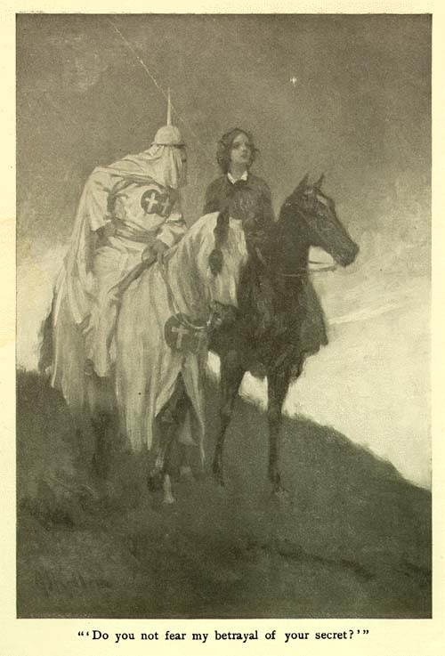
Thomas Dixon, The Clansman
Illustration from 1905 edition

Slide 36
Dissenters against emerging modes of Civil War Memory
Winslow Homer
Ambrose Bierce and dissent against “Reunionism”

Slide 37
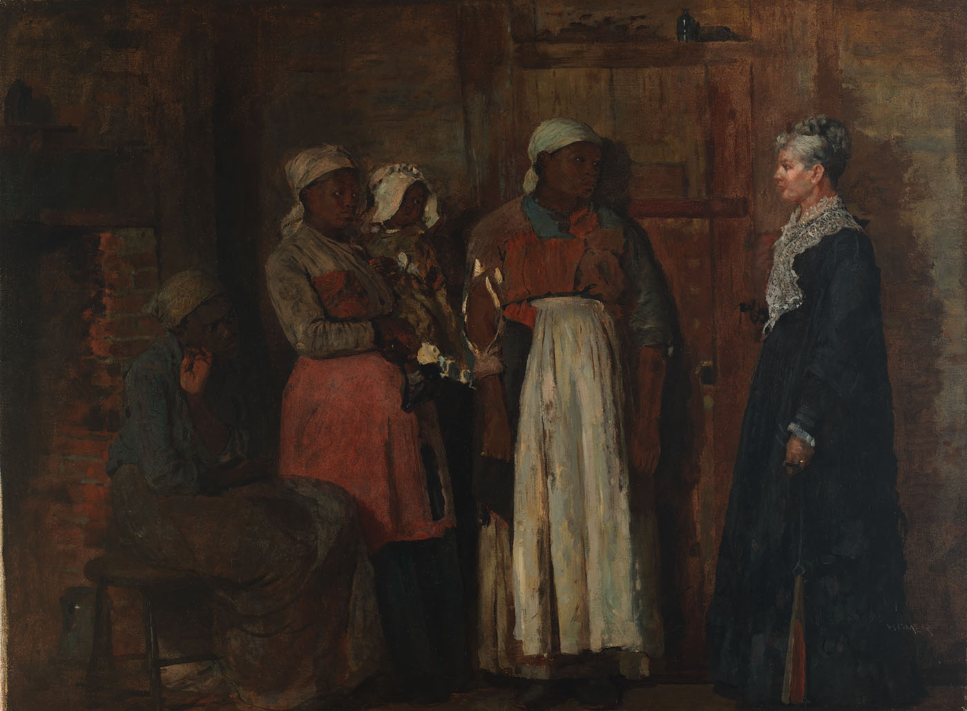

Slide 38
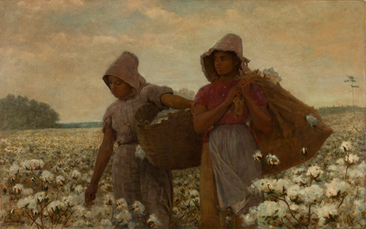
The Cotton Pickers
Winslow Homer, 1876

Slide 39
Near Andersonville
Winslow Homer, 1865-1866

Slide 40
A Visit from the Old Mistress
Winslow Homer, 1876

Slide 41
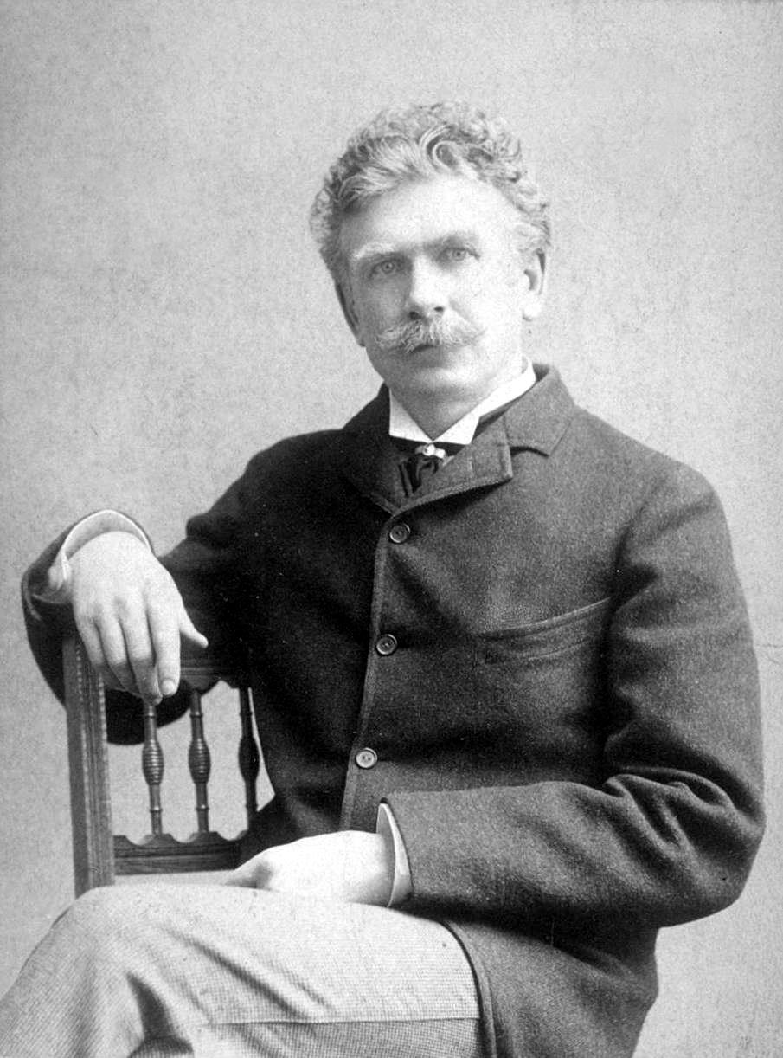
Ambrose Bierce and Dissent against Reunionism
(b. 1842- d.1914?)

Slide 42
D. W. Griffith
BIRTH OF A NATION
(1915)
https://archive.org/details/dw_griffith_birth_of_a_nation

